Slide 1
Tree Based Methods: Regression Trees

Slide 2
Agenda
I What are tree based methods?
Regression trees
Motivation using Hitter’s data set
How to interpret a regression tree
How to build a regression tree I Application

Slide 3
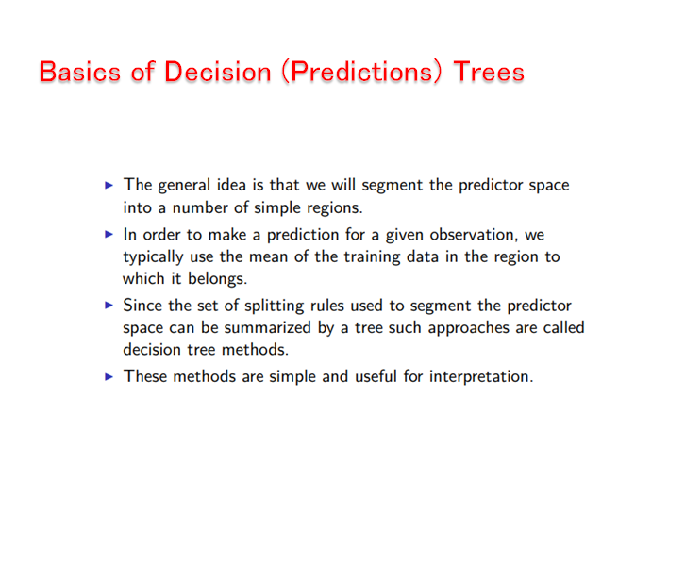

Slide 4
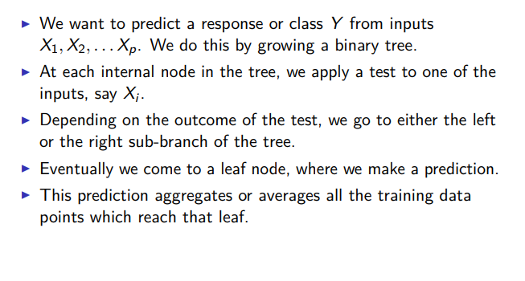
Basics of Decision Trees

Slide 5
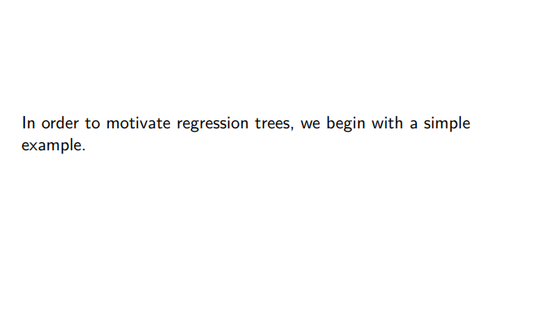
Regression Trees

Slide 6
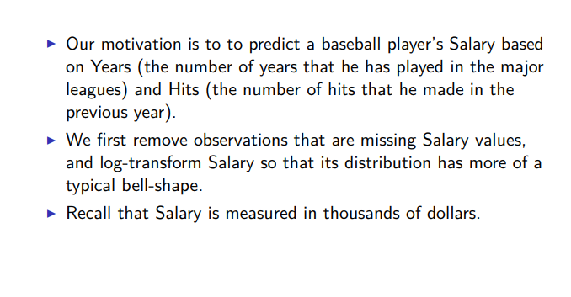
Prediction of baseball player’s salary

Slide 7
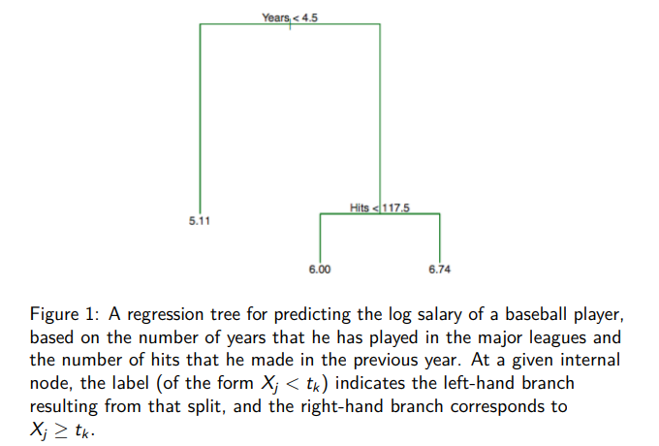
Prediction of baseball player’s salary

Slide 8
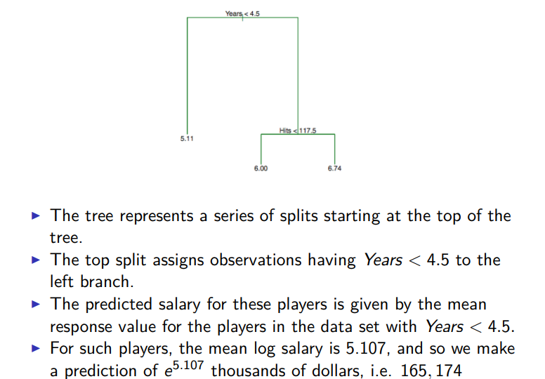
What does the tree mean?

Slide 9
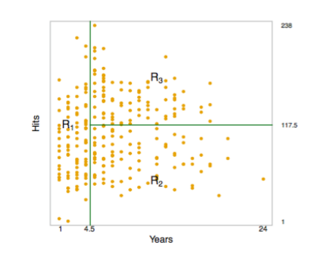
Prediction of baseball player’s salary

Slide 10
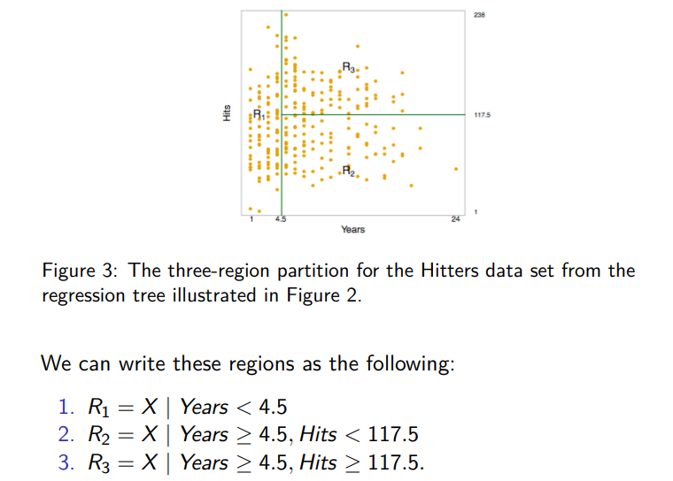
What do the regions mean?

Slide 11
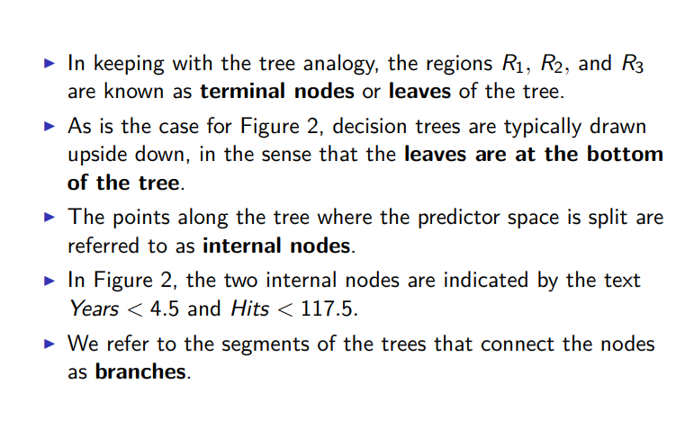
Terminology

Slide 12
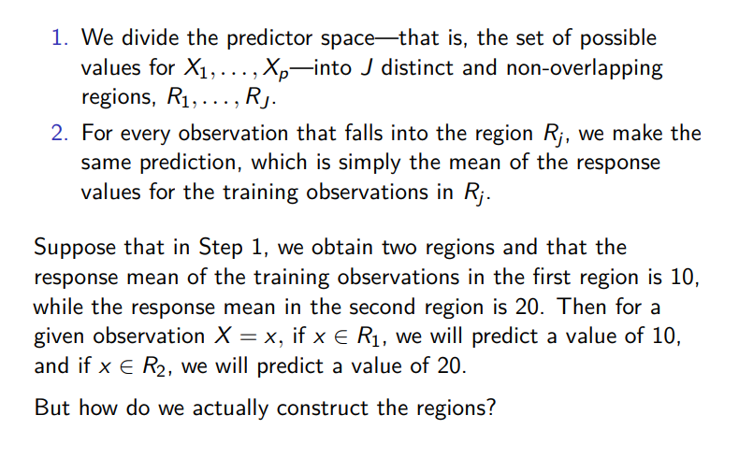
How do we build the regression tree?

Slide 13
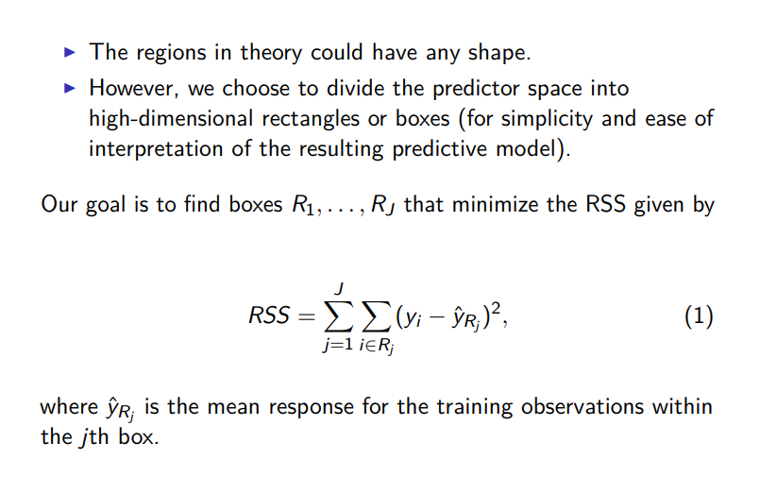
Constructing the regions

Slide 14
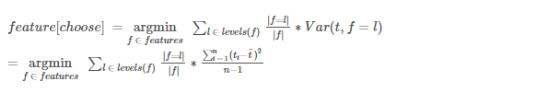
Algorithm for Building a Regression Tree
Feature to choose .
Here
f : denotes a single feature
L:denotes the value of a feature (e.g Price == medium),
t: denotes the value of the target feature in the subset.

Slide 15
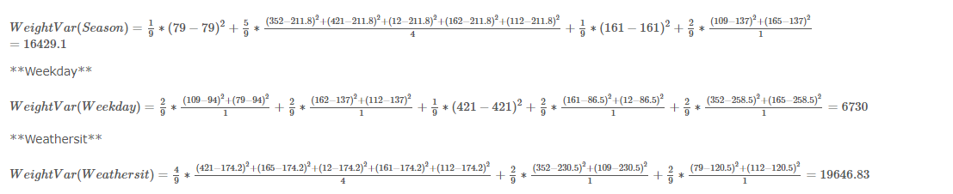
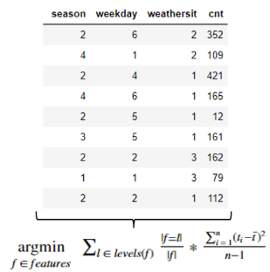
Caluclation

Slide 16
Thank You

